Slide 1

Notes:
#

Slide 2
TEAM INTRODUCTION
Title: AI-Driven Freshness Classification and Expiry Detection-Smart Vision Technology Quality Control
Team Name: Team Pravartak
Team Members:
College/University: Vishwakarma Institute of Information Technology,Pune
Date: 20-10-2024
Aniket Dhage | AI and ML Engineer, Python Developer, Data Scientist
Sanika Butle | Python Developer, Software Engineer

Slide 3
Executive Summary:
Objective
Extract the Details from Labels using OCR.
OCR to get expiry date details..
Develop a solution to detect the freshness and quality of fresh produce.
Scope
Classify Fresh and Rotten produce based on images along with Freshness Detection.
Integrate OCR to read details from the labels and extract the expiry dates where applicable.
Key Features
Accurate Details Extraction from labels with confidence scores.
Expiry date extraction and remaining days calculation for product shelf-life.
Real-time and accurate fresh produce detection and freshness evaluation.
Impact
Reduce manual efforts by automating the process.
Reduce food waste and enhance Inventory management.
Provides better Quality Insights.

Slide 4
Technical Approach:
Solution Overview
Image-based classification models trained to detect freshness and quality of produce.
OCR extracts text from labels, including expiry dates, for shelf-life calculation.
Multiple models tested to ensure optimal accuracy and performance.
Technologies Used
ResNet50, EfficientNetB0, DenseNet121, InceptionV3 for freshness detection and classification.
TensorFlow/Keras frameworks for seamless training and evaluation.
PaddleOCR for text recognition from labels.
Python, Kaggle Notebooks for model development and training.
Hardware Specifications
Training Environment: Kaggle/TensorFlow Cloud with GPU support for accelerated model training.
Better Quality Images for better accuracy and results.
Training Process
Dataset: Images of fresh and rotten fruits/vegetables labeled accordingly.
Preprocessing: Resized to 180x180 pixels for model consistency.
Loss Function & Optimizer: Sparse Categorical Crossentropy with Adam Optimizer.
Evaluation Metrics: Model accuracy, validation loss curves and confusion matrices tracked throughout for better analysis of performance.
Code and Simulation : Github

Slide 5
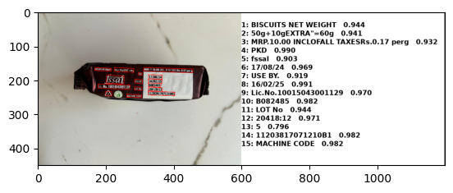
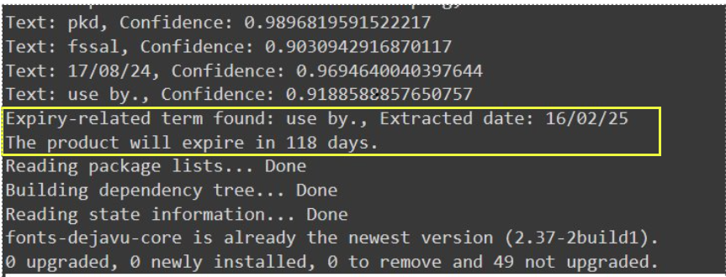
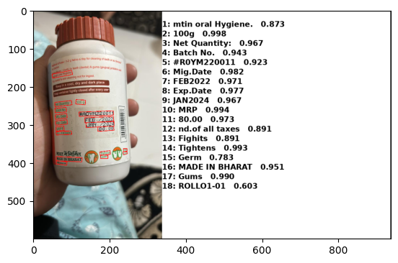
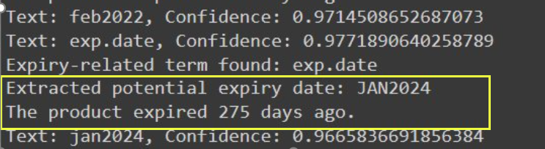
Output
Use case 1 - OCR to extract details from image/label
Use case 2 - Using OCR to get expiry date details

Slide 6
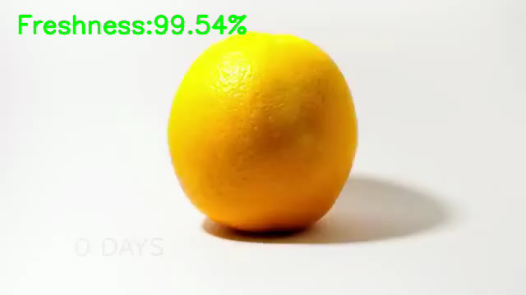
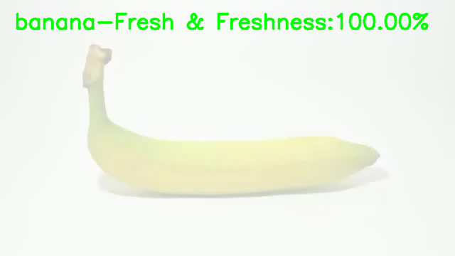
Output – Use Case 4 (Detecting freshness of fresh produce)

Slide 7
Thank You!

